Slide 1
AZ-900T0x Module 01: Cloud concepts
Notes:
Adjust the title page for AZ-900T00 or AZ-900T01.

Slide 2
Lesson 01: Learning objectives

Slide 3
Module 1 – Learning objectives
Describe and understand cloud services and their benefits.
Understand key terms you will encounter when working with cloud services.
Understand public, private, and hybrid cloud models.
Understand infrastructure as a service (IaaS).
Understand platform as a service (PaaS).
Understand software as a service (SaaS).

Slide 4
Lesson 02: Why cloud services?

Slide 5
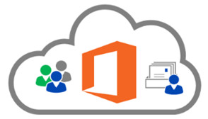
Cloud computing
Compute power - such as Linux open source servers or web applications.
Storage - such as files and databases.
Networking - such as secure connections between the cloud provider and your company.
Analytics - such as visualizing telemetry and performance data.
Cloud providers include Microsoft, Amazon, and Google
Notes:
Cloud computing - https://azure.microsoft.com/en-us/overview/what-is-cloud-computing/

Slide 6
Key concepts
High availability
Fault tolerance
Scalability
Elasticity
Global reach
Customer latency capabilities
Agility
Predictive cost considerations
Disaster recovery
Security
Notes:
There is a term reference guide available at https://azure.microsoft.com/en-us/overview/cloud-computing-dictionary/

Slide 7
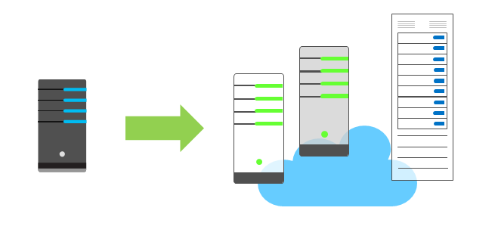
Economies of scale
The concept of economies of scale is the ability to reduce costs and gain efficiency when operating at a larger scale in comparison to operating at a smaller scale.
Cloud providers are very large businesses, and thus can leverage the benefits of economies of scale and then pass those benefits on to their customers.

Slide 8
CapEx vs. OpEx
Capital Expenditure (CapEx)
Spend on physical infrastructure upfront.
Deduct the expense from your tax bill.
High upfront cost, value of investment reduces over time.
Operational Expenditure (OpEx)
Spend on services or products as needed.
Get billed immediately.
Deduct the expense from your tax bill in the same year.
No upfront cost, pay-as-you use.

Slide 9
Consumption-based model
No upfront costs.
No need to purchase and manage costly infrastructure.
Ability to pay for additional resources as they are needed.
Ability to stop paying for resources that are no longer needed.

Slide 10
Lesson 03: Types of cloud models

Slide 11
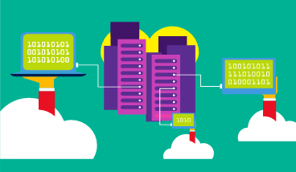
Public cloud
Owned by cloud services or hosting provider.
Provides resources and services to multiple organizations and users.
Accessed via secure network connection (typically over the internet).
Notes:
What are public, private, and hybrid clouds? - https://azure.microsoft.com/en-us/overview/what-are-private-public-hybrid-clouds/

Slide 12
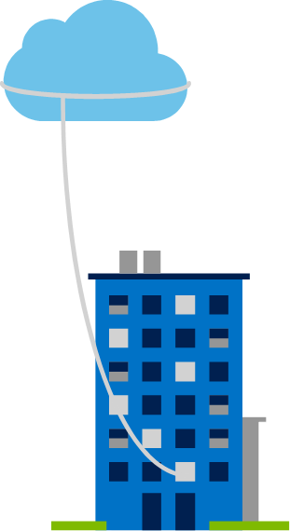
Private cloud
Owned and operated by the organization that uses cloud resources.
Organizations create a cloud environment in their datacenter.
Self-service access to compute resources provided to users within the organization.
Organizations responsible for operating the services they provide.

Slide 13
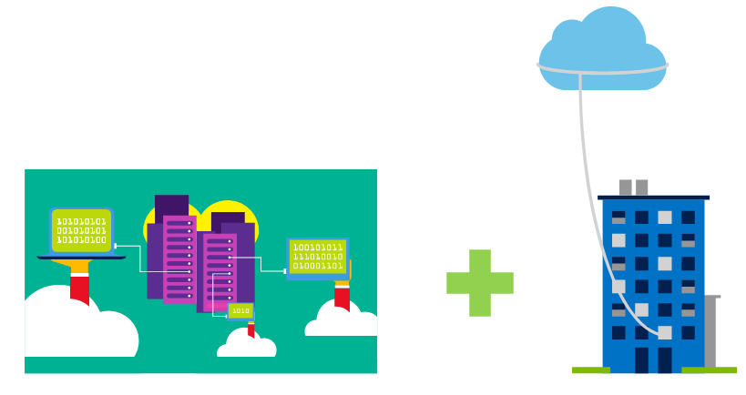
Hybrid cloud Mutli-cloud
Combines Public and Private clouds to allow applications to run in the most appropriate location.

Slide 14
Cloud model comparison
Public cloud:
No capital expenditures to scale up.
Applications can be quickly provisioned and deprovisioned.
Organizations pay only for what they use.
Private cloud:
Organizations have complete control over resources.
Organizations have complete control over security.
Hybrid cloud:
Most flexibility.
Organizations determine where to run their applications.
Organizations control security, compliance, or legal requirements.

Slide 15
Lesson 04: Types of cloud services

Slide 16
Shared responsibility model
On-Premises
( Private Cloud )
Infrastructure
( as a Service )
Platform
( as a Service )
Software
( as a Service )
Data & Access
Data & Access
Data & Access
Data & Access
Applications
Applications
Applications
Applications
You Manage
Runtime
Runtime
Runtime
Runtime
Cloud Provider Manages
Operating System
Operating System
Operating System
Operating System
Virtual Machine
Virtual Machine
Virtual Machine
Virtual Machine
Compute
Compute
Compute
Compute
Networking
Networking
Networking
Networking
Storage
Storage
Storage
Storage
Notes:
IaaS, PaaS, and SaaS have dedicated topics, coming up.

Slide 17
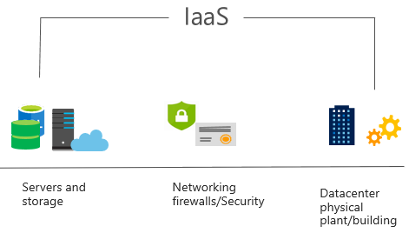
Infrastructure as a Service (IaaS)
Most basic cloud computing services category.
Build pay-as-you-go IT infrastructure by renting servers, virtual machines, storage, networks, and operating systems from a cloud provider.
Instant computing infrastructure, provisioned and managed over the internet.
Notes:
For more information on IaaS, visit https://azure.microsoft.com/en-us/overview/what-is-iaas/

Slide 18
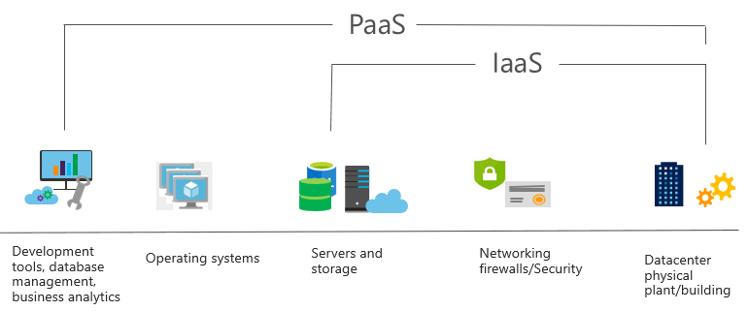
Platform as a Service (PaaS)
Provides environment for building, testing, and deploying software applications.
Helps create applications quickly, without focusing on managing underlying infrastructure.
Notes:
For more information on PaaS, see https://azure.microsoft.com/en-us/overview/what-is-paas/

Slide 19
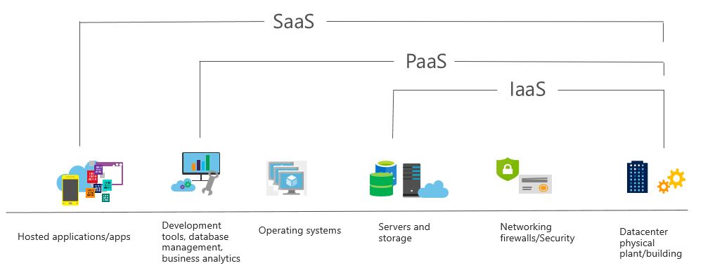
Software as a Service (SaaS)
Centrally hosted and managed software for end users. Users connect to and use cloud-based apps over the internet. For example, Microsoft Office 365, email, and calendars.
Notes:
Common usage scenarios:
Examples of Microsoft SaaS services include Microsoft Office 365, Skype, and Microsoft Dynamics CRM Online.
For more information on SaaS, see https://azure.microsoft.com/en-us/overview/what-is-saas/

Slide 20
Cloud service comparison
IaaS
PaaS
SaaS
The most flexible cloud service.
You configure and manage the hardware for your application.
Focus on application development.
Platform management is handled by the cloud provider.
Pay-as-you-go pricing model.
Users pay for the software they use on a subscription model.
Notes:
The slide contains only some of the cloud service comparison discussion points.

Slide 21
Lesson 05: Module review questions
Notes:
As you have time go through the Module Review questions in the student materials.

